Slide 1
Data Pipelines in Azure
Ben Edmondson | ElastIQ-Connect

Slide 2



Who am I?
Jack of all trades,
Master of as many as I can manage
Full stack software engineer
Backend - Python (Django/FastAPI)
Frontend - JavaScript (Vue.js)
Data Engineering
Cloud Engineering – Azure
User Requirements/Experience
Teach programming courses

Slide 3

Who am I?
Double Civil Engineering Degree
Hydraulic Engineering
Structural Engineering
Structural Engineer @Royal Haskoning
All round developer @Royal Haskoning
Tech Lead @ Royal Haskoning
Full Stack Software Engineer @ElastIQ-Connect

Slide 4

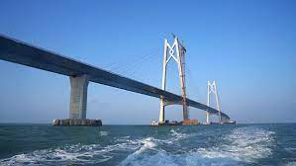
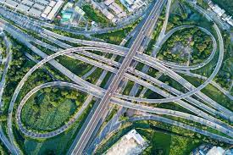

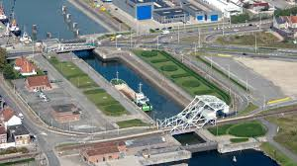
Infrastructure

Slide 5

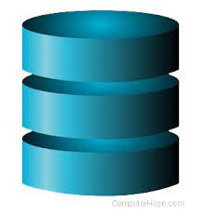
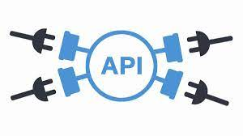



Data Infrastructure

Slide 6

Data in today's world
“Any sufficiently advanced technology is indistinguishable from magic”
~Arthur C. Clarke

Slide 7

Supporting the Science
If Data was a parade, Data Science is the wagons and Data Engineering is everything else.

Slide 8
Supporting the Science
Top complaints by Data Scientists
Inaccessible data
‘Dirty’ data
Not knowing where the data is
Slow data loading/saving/streaming
No data trails
Not having Data Engineers in their team

Slide 9
Wat is Azure?
Microsoft’s cloudservice provider platform
Started in 2010 following AWS and Google Cloud
More than 200 different services with more every month
Understanding all of these is its whole own job

Slide 10
Wat is Azure?
Provide basic elements
Databases
CPU’s
(Blob) Storage
Security
But also very fancy things
ML Model training platform
IoT solutions
Plug-and-play AI modules

Slide 11
IaaS, PaaS, SaaS
Infrastructure as a Service
Rent IT infrastructure like servers/VM’s/etc. on a pay-as-you-go basis
Platform as a Service
Cloud based building blocks for applications
Software as a Service
Software run from the cloud
Main difference is who manages what

Slide 12
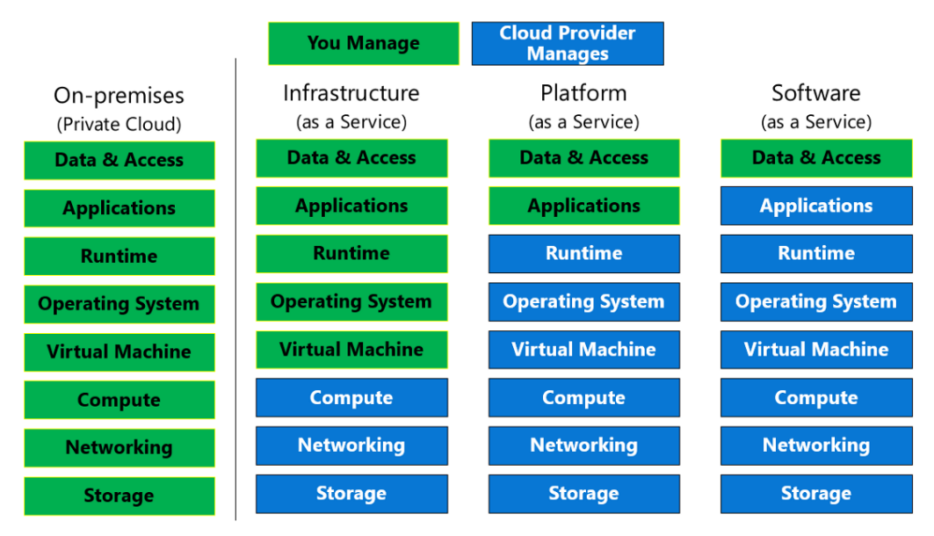
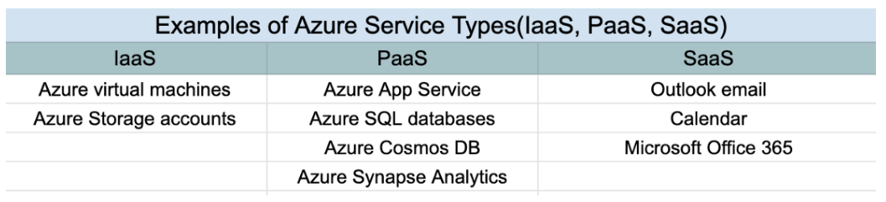
IaaS, PaaS, SaaS

Slide 13
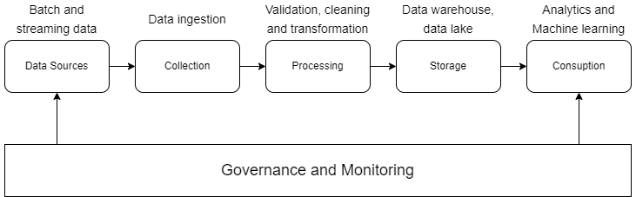
The data workflow

Slide 14
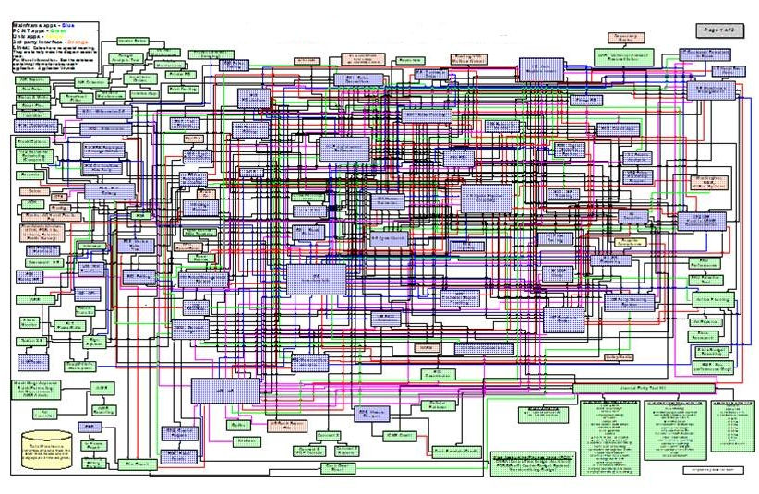
The data workflow

Slide 15
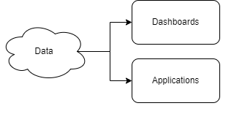
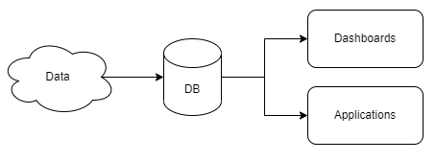
The data workflow

Slide 16
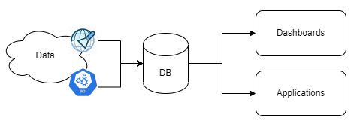
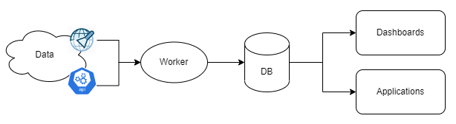
The data workflow

Slide 17
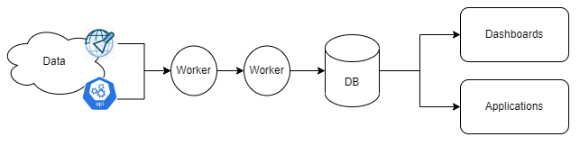
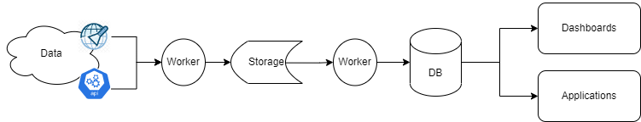
The data workflow

Slide 18
The data workflow

Slide 19
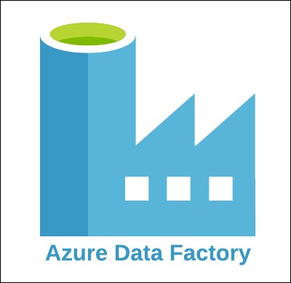

Azure Functions vs. Azure Data Factory
VS.

Slide 20
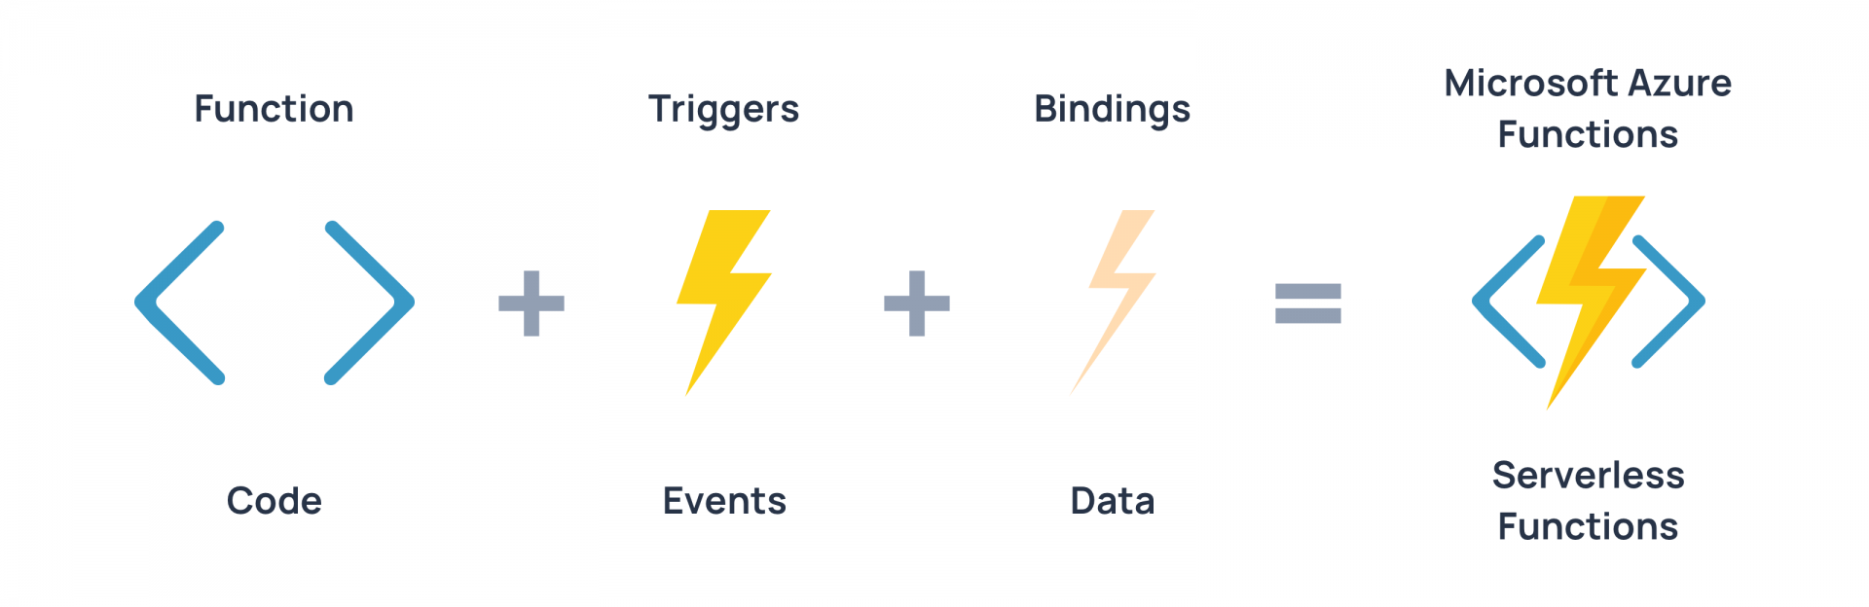
Azure Functions

Slide 21
Azure Functions
Supports most common languages
C#, JavaScript, F#, Java, Powershell, Python, TypeScript
Three main triggers
Http, Timer, Blob
Can be bound to Azure resources
IoT, DB’s, Web Apps, Event Hubs etc.
Pay per second the code is running

Slide 22
Azure Functions Pros/Cons
Pros
Pay per second
Flexible language choice
Easy deployment with VSCode
Handle load peaks well
Intergrated logging
Cons
Limited run time (5/30mins)
Need to know code
Scaling limits (max 100 threads)
No R support
Not good for data streams

Slide 23

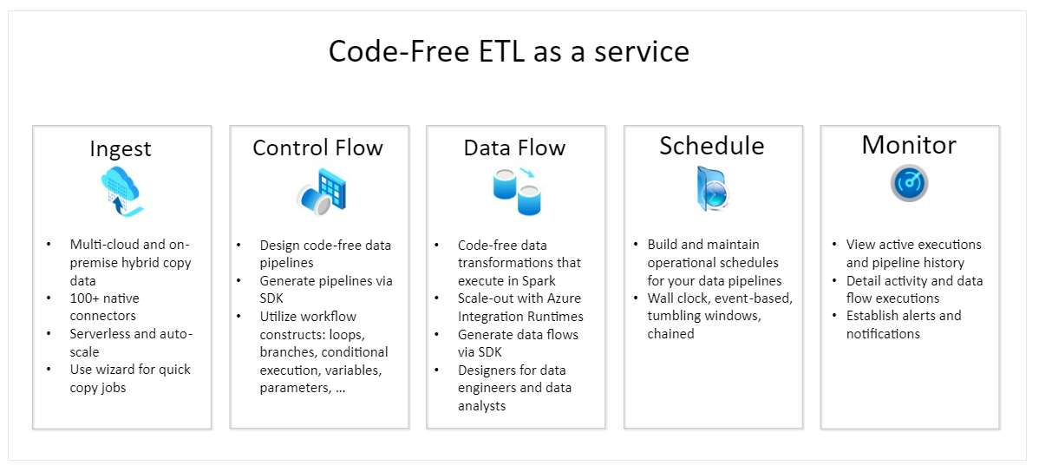
Azure Data Factory

Slide 24
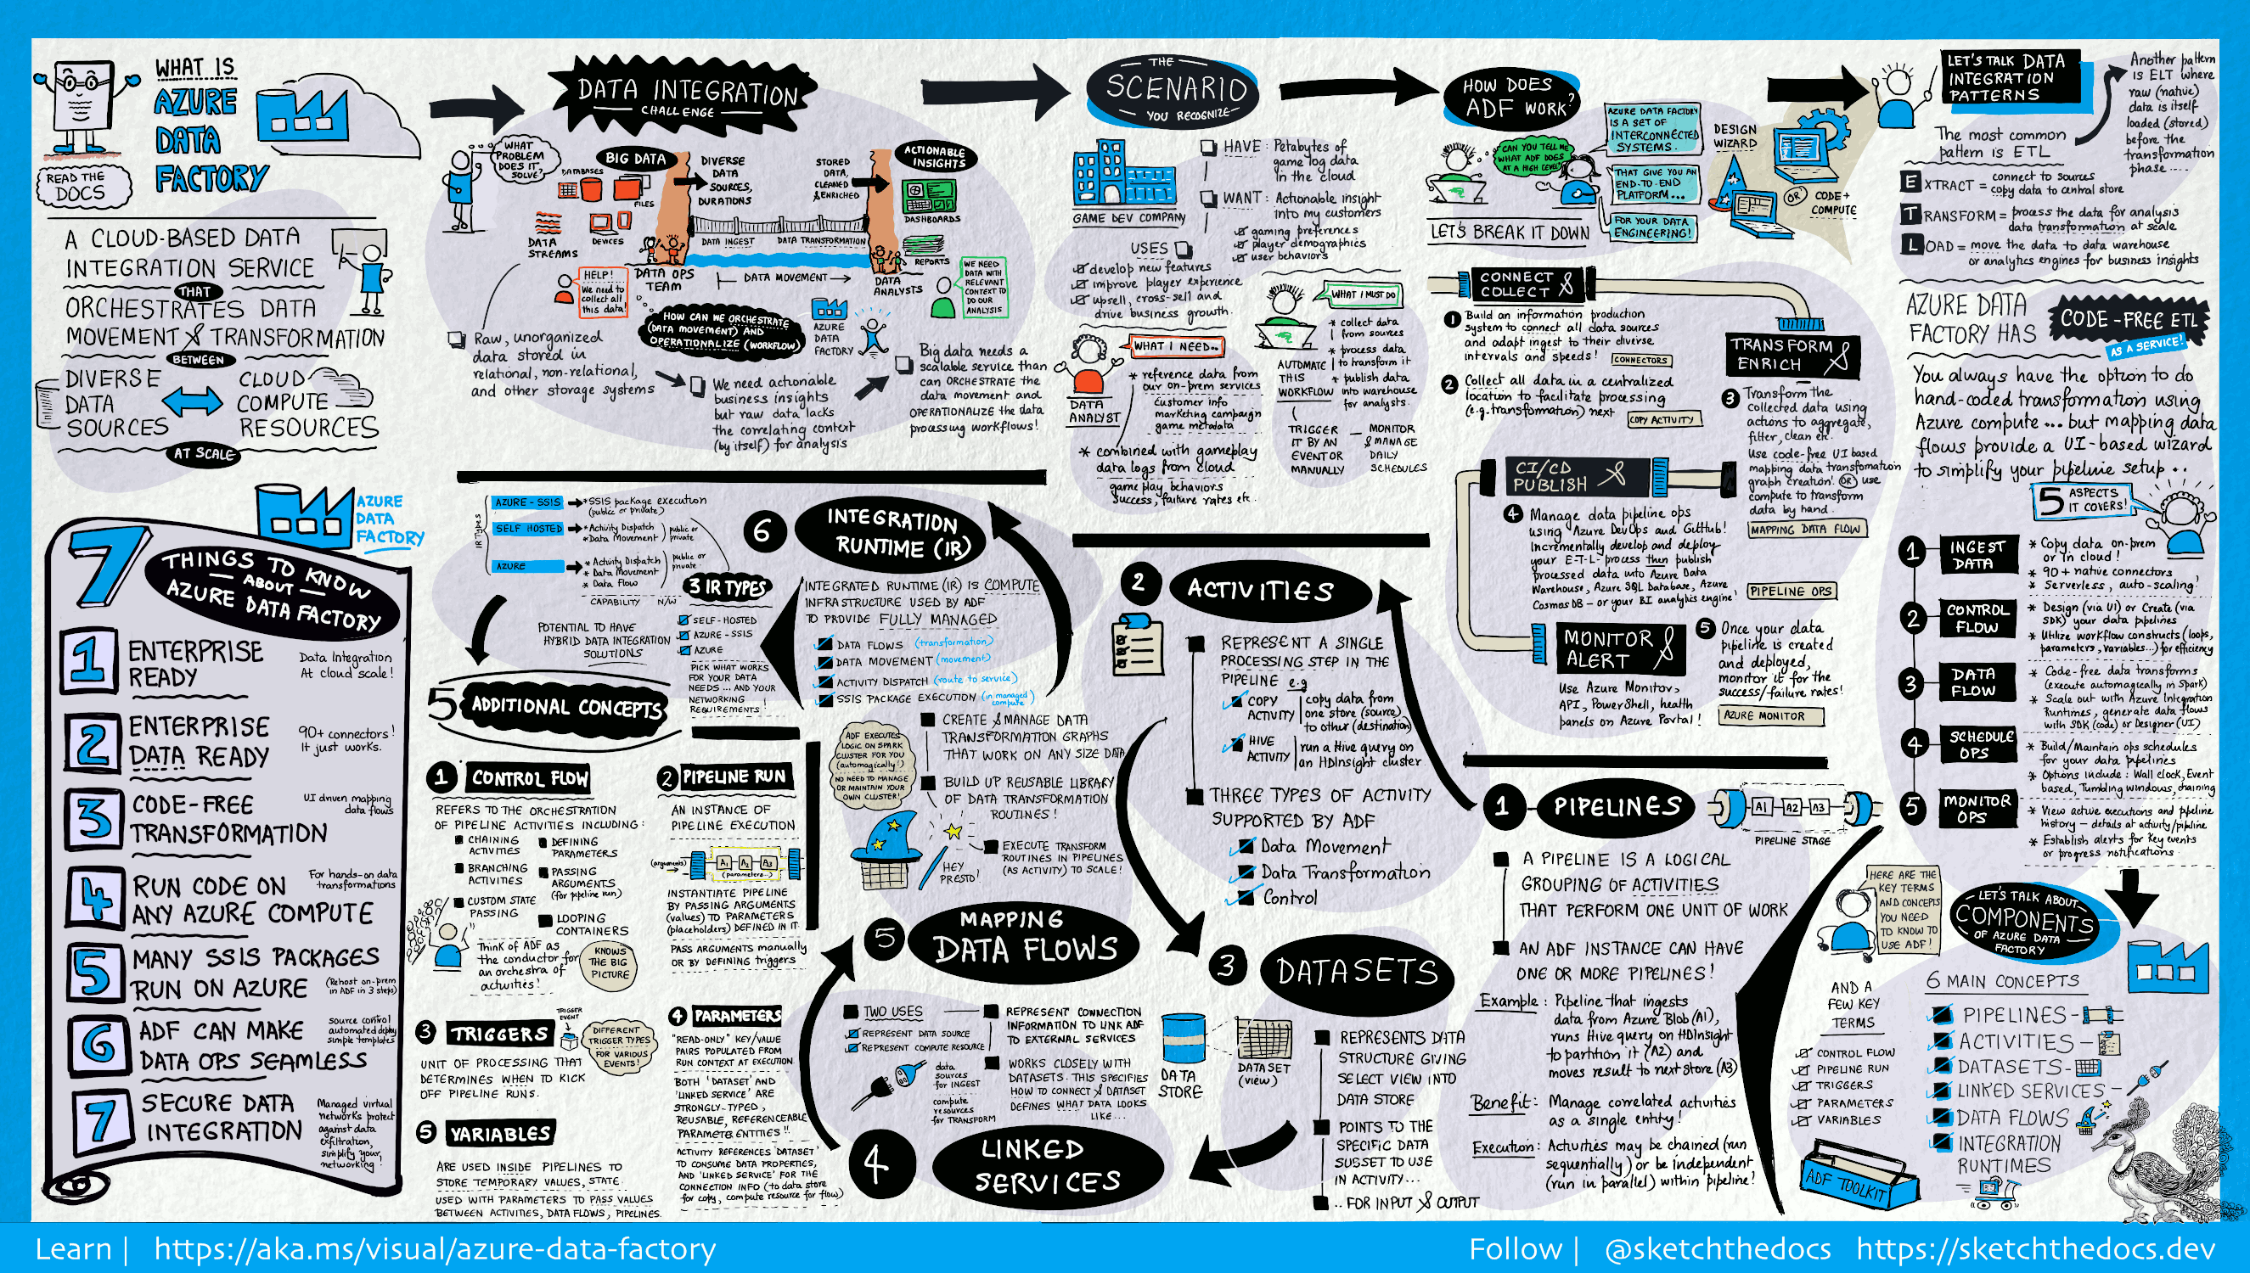
Azure Data Factory

Slide 25
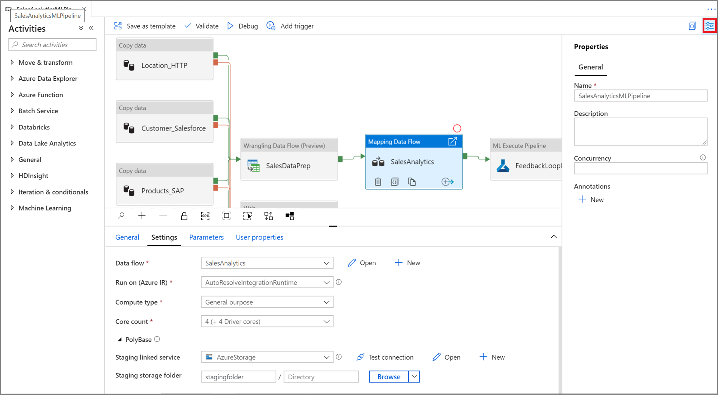
Azure Data Factory

Slide 26
Azure Data Factory Pros/Cons
Pros
Low/No Code
Easy to bring multiple data stream together
Can run on event or stream
Integrates well out of Azure
Visual view of your pipeline
Cons
Pay per pipeline
Not made to run custom code
UI can be clunky

Slide 27
For today…
Azure Functions!

Slide 28
BREAK
Ben Edmondson | ElastIQ-Connect

Slide 29
Deploying Azure Functions
An Azure Function is really a group of resources working together
Function Code
Binding schema
Actual code
Function App – Houses the function code
App Service Plan – Houses the Function App
Storage Account – Handles the queue, and as default for any data blobs
Application Insights – Handles the logging

Slide 30
Deploying Azure Functions
3 Ways to deploys the resources
VSCode
Azure Portal
ARM Templates
3 Ways to deploy the code
VSCode
Azure Portal
Command Line

Slide 31
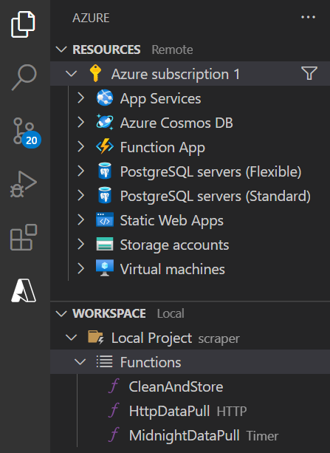
VSCode Integration
Easiest way to deploy everything from one place
<10 clicks! I think….

Slide 32
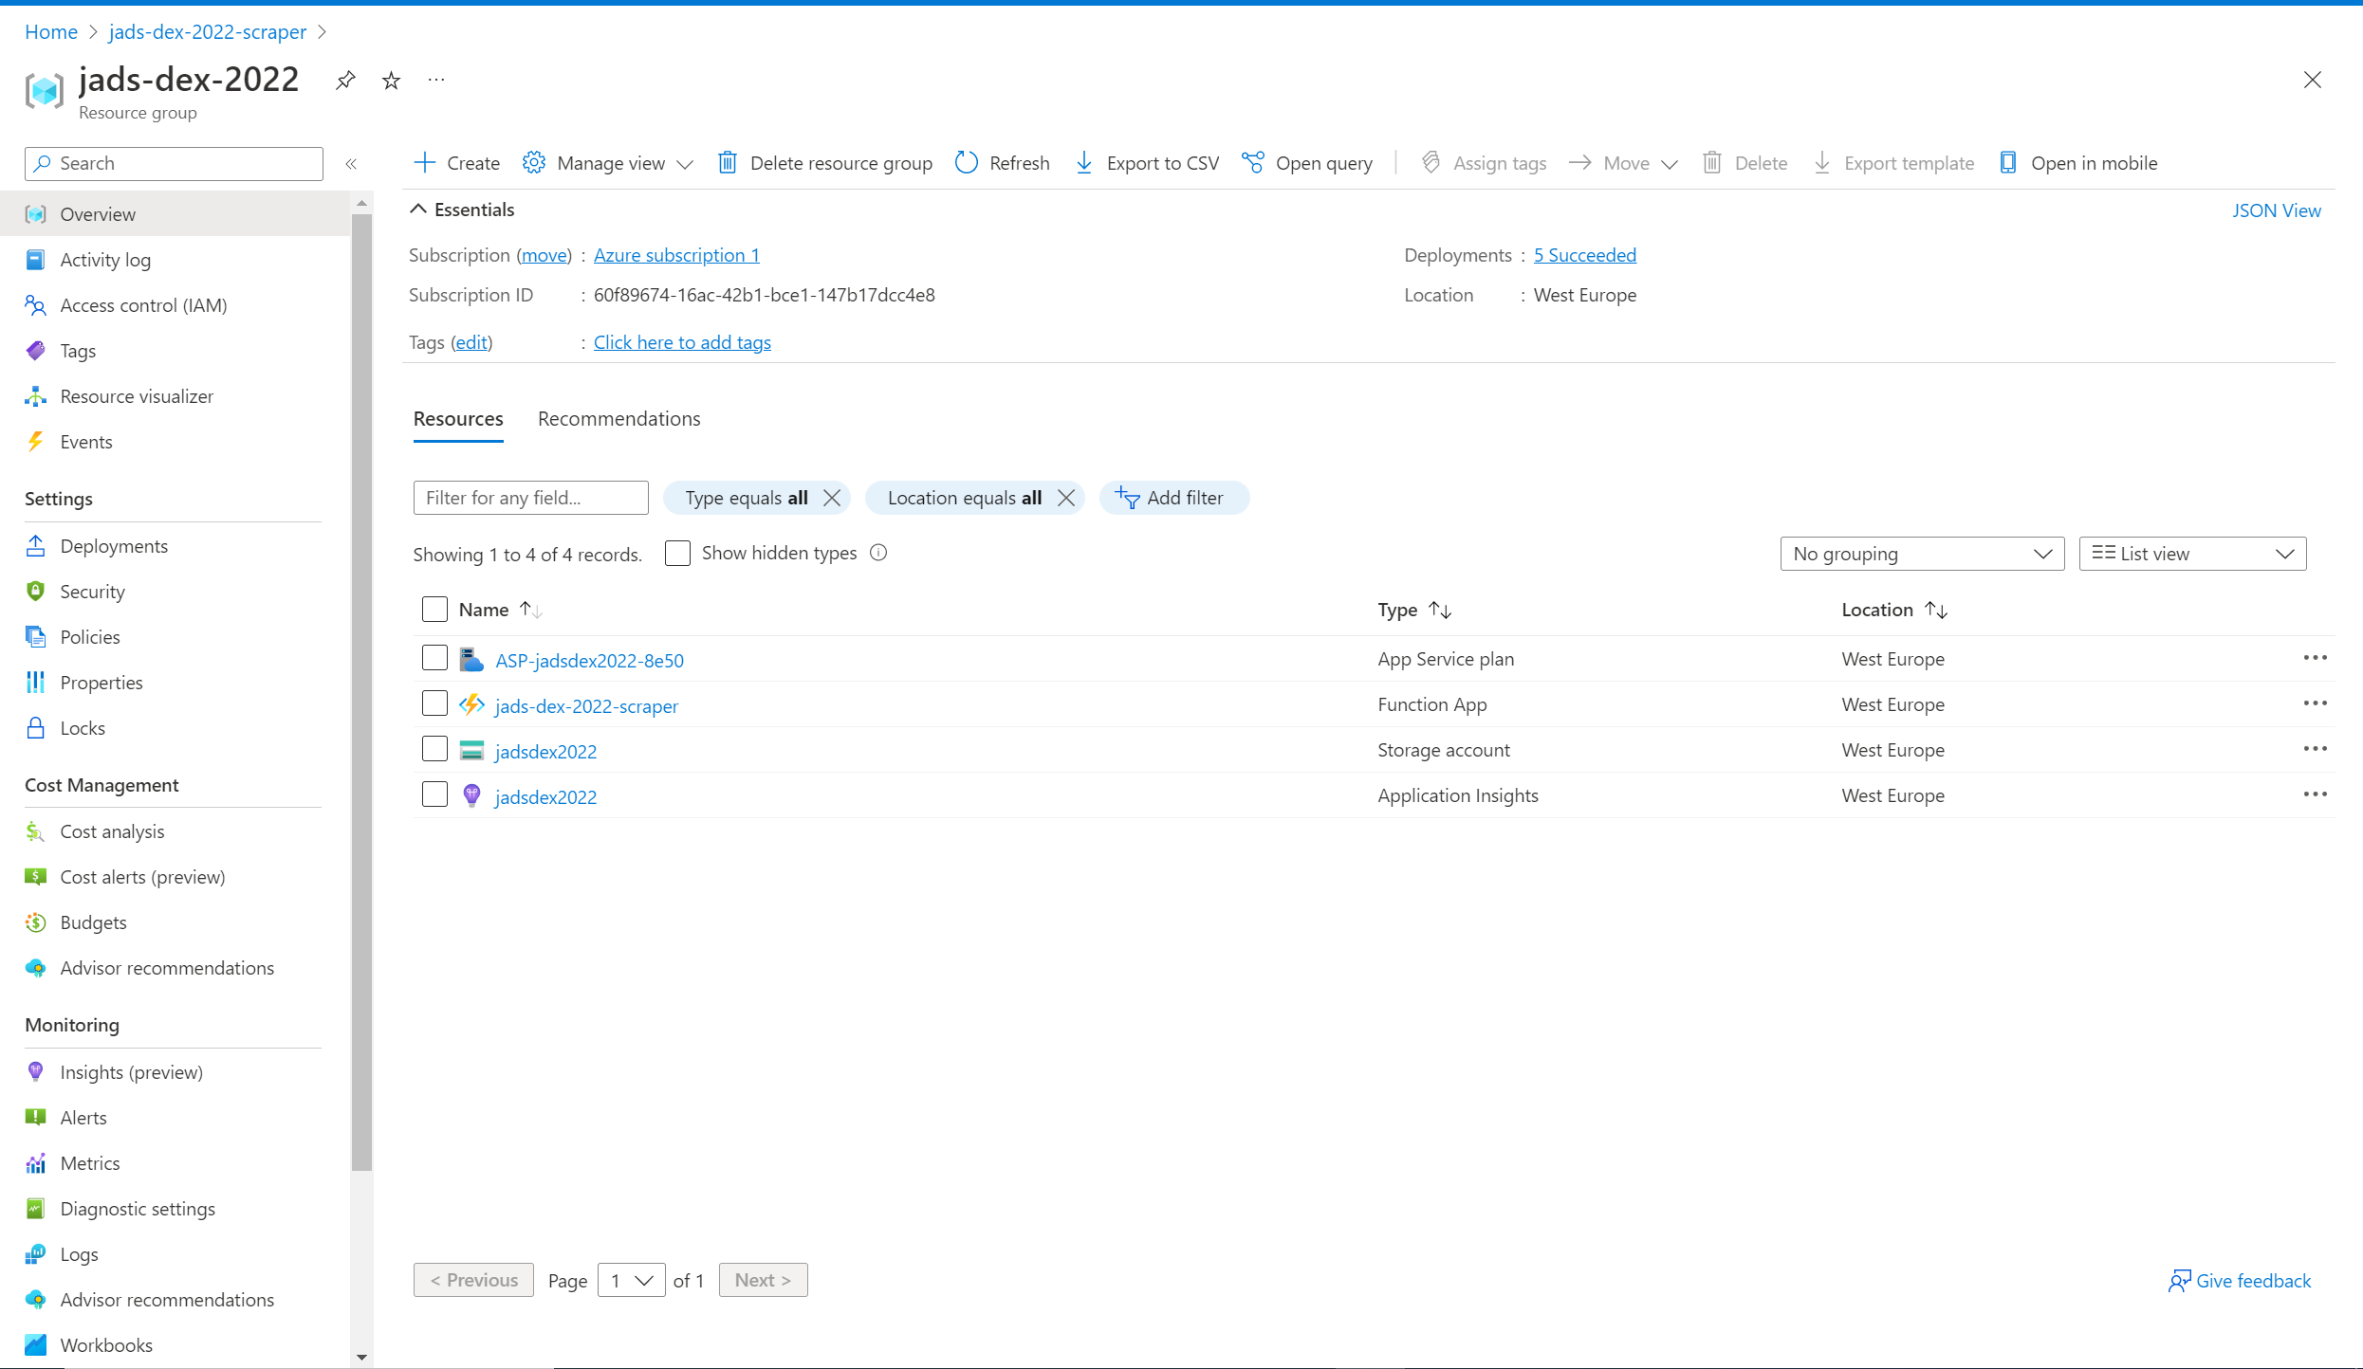
Azure Portal
Most settings you can tweak, but high barrier of entry
Not meant as a code manager

Slide 33

Templates
File containing cloud resource setup
Making them is hard, using them is easy
Examples are Terraform, ARM and BICEP

Slide 34
Todays Workflows
Raw weather data -> Structured DB of weather data
KNMI ‘scraper’
Daily runs
Clean to valid csv file
Data Processor
Runs when new data is available
Arbitrary cleaning step
https://github.com/BenEdmondson

Slide 35


KNMI Data
Weather data
>200 stations in NL
Accurate and up to date
Weather affects a lot of processes in the world

Slide 36
KNMI Data
KNMI weather data is widely used by companies
It’s freely accessible through their API
This sounds great, but there are issues…
Data format is awkward
Depending on the query it can take a while

Slide 37
Example Application
A Dashboard which plots precipitation (rain) for an arbitrary weather station in the Netherlands.
Requires historical data
Requires up to date data
Requires granular data
Feel responsive and ‘snappy’

Slide 38
Example Application
A Dashboard which plots precipitation (rain) for an arbitrary weather station in the Netherlands.
You do not want you BI dashboard to do the heavy lifting
You do not want to keep refetching identical data

Slide 39
Example Application
A Dashboard which plots precipitation (rain) for an arbitrary weather station in the Netherlands.
Solution:
Pull the bulk of your data in and store
Fetch recent data daily to add to the store

Slide 40
Example Application
A Dashboard which plots precipitation (rain) for an arbitrary weather station in the Netherlands.
Pros
You have backed up data
You control the format
Can do arbitrary transformations
Cons
Large quantity of storage needed
‘Moving parts’ you need to manage

Slide 41
Scheduled Web Scraper
Run every day
Change data format to a clean csv
Save it somewhere

Slide 42
File Triggered Data Transfer
Pick up csv from the scraper
Run arbitrary code on it
Store it in a database for easy access
We’ll be running a data compression which works well for this specific data

Slide 43


Now in practice!

Slide 44
Building Block to Complex Systems
Building a complete system with Azure Functions is effectively a serverless microservices architecture.
It can be expanded as much as you need. The cloud is the limit!

Slide 45
Remember this?

Slide 46
Expand upon this base
Function to wipe storage every X time
CI/CD
Key vault
Messaging on runs/error
…

Slide 47
Data Pipelines in Azure
Ben Edmondson | ElastIQ-Connect

